Slide 1
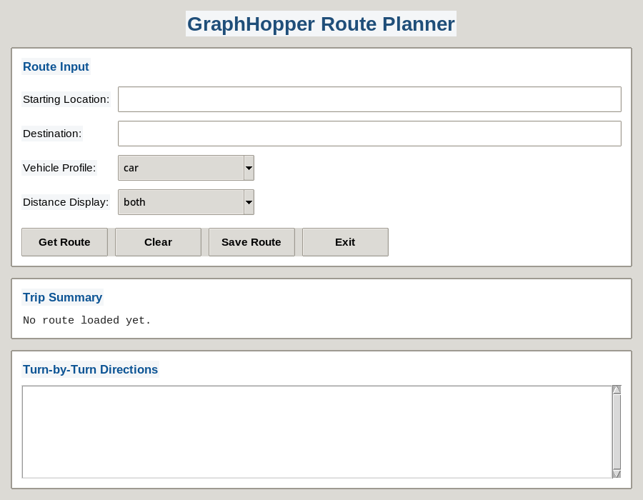
GraphHopper Route Planner
Feature-enhanced Lab 4.9.2 application with UI improvements, flexible distance display, repeat search prompt, basic validation, and summary export.
Project goal
Create a cleaner desktop route-planning app that is easy to use, easy to explain, and easy for another team to continue.
Main stack
Python, Tkinter, Requests, GraphHopper Geocoding + Routing APIs
Deliverables covered
Features, design rationale, code/documentation, demo, backlog, reflections, and rubric alignment
GraphHopper Route Planner project presentation

Slide 2
Application features selected by the team
Each enhancement focused on usability and a manageable project scope
Feature summary
Christian
Cleaner UI, colored headings, numbered directions, table-style summary, clearer prompts.
Clark
Distance display in miles only, kilometers only, or both.
Klent
Prompt after each route to search another route or exit.
Aldren
Blank-field validation and invalid vehicle defaults back to car.
Kient
Save only the main trip summary to a text file.
Why these features made sense
The team chose features that make the app easier to use and easier to maintain: better layout, simple validation, flexible distance display, repeat-search workflow, and a lightweight export feature for handoff or record-keeping.
GraphHopper Route Planner project presentation

Slide 3
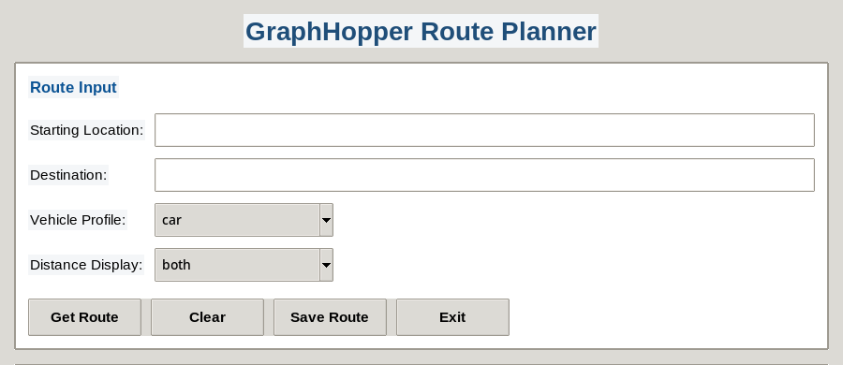
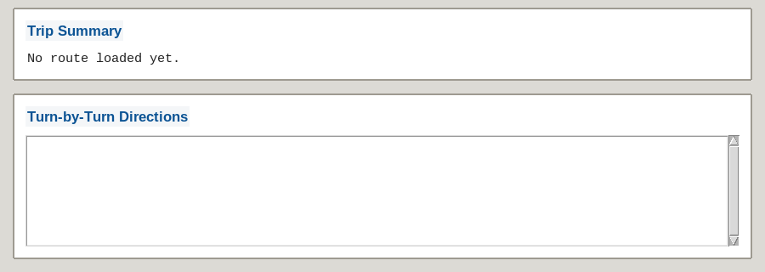
Application overview and interface demonstration
Screens show the cleaner layout, colored headings, numbered directions, and table-style trip summary
Users enter a starting location and destination.
Vehicle choices remain simple: car, bike, or foot.
Distance can be shown in one unit or both units.
The output area shows a concise trip summary plus numbered directions.
Clear prompts guide the user after each route is displayed.
GraphHopper Route Planner project presentation

Slide 4
Code, comments, and handoff documentation
The code is commented by feature so another team can continue the project
How another team can continue
• geocoding() and get_route() isolate the API logic.
• GraphHopperApp contains the full UI workflow.
• Feature comments mark where each enhancement begins.
• last_route_data keeps the current result ready for export.
Documentation standard used
Comments explain each feature, the related UI behavior, and where future changes should be added. That makes the project easier to hand off, debug, and extend.
Continuation path
A new team can start from validation, repeat-route prompts, or file export without changing the rest of the interface.
GraphHopper Route Planner project presentation

Slide 5
Application demonstration
User flow from search to result to saving the trip summary
Demo steps
1. Enter start and destination.
2. Choose vehicle and distance display.
3. Click Get Route to load summary and numbered directions.
4. Choose to search again or stay on the current screen.
5. Save only the main trip summary to a text file.
Export example
TRIP SUMMARY
====================================Starting Location : London
Destination : Manchester
Vehicle : car
Distance : 200.5 miles / 322.8 km
Duration : 04:11:18
GraphHopper Route Planner project presentation

Slide 6
Backlog and reflection points
Future enhancements and lessons learned while building the application
Future enhancements (backlog)
Reflection points
• Let the user choose the save location and file name.
• Add a map preview of the route.
• Support more travel profiles and route preferences.
• Add recent-search history or favorites.
• Add unit tests and stronger API-failure recovery.
Issue: balancing useful features with a limited project scope.
Solution: choose enhancements that add visible value without overcomplicating the app.
Issue: users need clear feedback when inputs are missing or invalid.
Solution: blank-field checks, default vehicle fallback, and clearer prompts/messages.
Learning: modular code plus comments makes collaboration and continuation much easier.
GraphHopper Route Planner - backlog and reflection

